Slide 1
Status update – our project
Mark Karle and Turner Strayhorn

Slide 2
Shell
The shell singleton works. It starts with a path and gains proper access of the terminal and ignores signals to it.

Slide 3
ShellReactor
The reactor handles input events and dispatches to the interpreter to decide what to do to the input
Perhaps signals should also be handled here, like ctrl + c?
Saying exit ends the shell instance

Slide 4
ShellParser
Our interpreter is simple. We decided not to do boost spirit because it seemed simple enough to interpret without it.
The Parser splits the input by spaces and creates a vector of strings with the input.
Then it checks if the command is a supported native command such as cd, but right now these commands do nothing
If it is not, it creates a Process object which will launch with the command arguments in the vector created by the parser
Later we will allow pipes which will probably create a vector of Processes
Background commands start with & instead of end with it

Slide 5
Process
Process represents a command.
Process can launch in the foreground or background
It will fork and exec based on the parameters it is passed, but we have not implemented the actual forking yet.

Slide 6
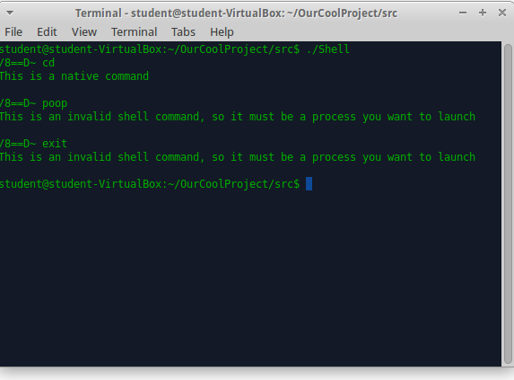
Example

